Slide 1
Homogeneous coordinates: –
consistent notation
several other good points (later)

Slide 2
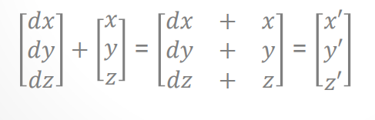
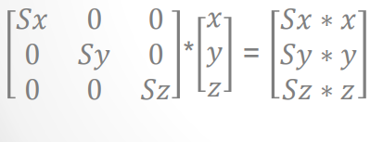
Translation
Scaling

Slide 3
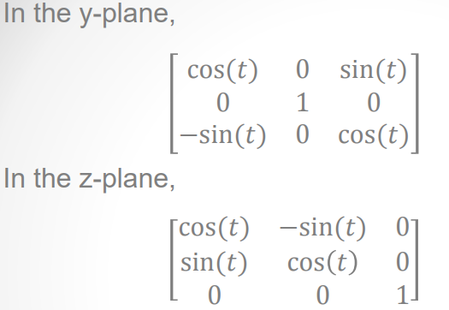
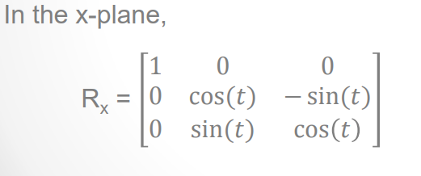
Rotation

Slide 4
We know that a translation matrix can be combined with a translation matrix, scaling matrix with a scaling matrix and a rotation matrix with a rotation matrix. Since scaling and rotation matrices are 3*3 matrices, they can be combined as well, i.e. we can combine several scaling matrices with several rotation matrices. Translation matrices are additive in nature, therefore, we can not combine translation matrices with scaling and rotation matrices.

Slide 5
Basically, homogenous coordinates allow combine transformations to be easily represented by a matrix. The conversion to homogenous transformation is quite simple and allows for multiplication instead of addition when dealing with translation.

Slide 6



The point (x, y) of plane in homogeneous system is denoted by triple
which preserves proportionality class of triples with
If is not equal to zero, we can multiply every coordinate of by 1/ to obtain equivalent point
which is same as
i.e. the Euclidean point (x,y) can be extended to homogeneous coordinate simply by adding „1” as third coordinate. For example, the points (2,1,1), (4,2,2) (200,100,100)… all corresponds to same Euclidean point (2,1).

Slide 7
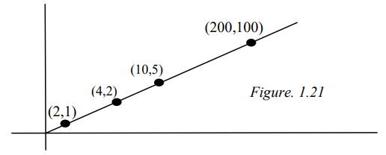
Euclidean coordinate (x,y) corresponds to homogeneous coordinate (x,y,1)

Slide 8
What happens if w ≠ 1 ?
• Well if w ≠ 1 then we can simply use our above calculation to find out the point we are working with.
• Consider the following however, [1 2 3 0.1]= [10 20 30 1] [1 2 3 0.001]= [1000 2000 3000 1] [1 2 3 0.000000001] = a point very far away.
• So that w tends to 0, we can start thinking about the point very far away; i.e at infinity.
• This also allows us to represent vectors and scalars in the same fashion, using w=1 represent a scalar value or a point and w=0 to represent a vector in that direction.

